Slide 1

Practical 9
Swap Nodes pairwise in a linked list.

Slide 2

Lesson Plan
Subject/Course | Competitive Coding
Lesson Title | Swap Nodes pairwise in a linked list.
Lesson Objectives
Rearrange the linked list so every two adjacent nodes are swapped (1↔2, 3↔4, ...).
Do it in O(n) time and O(1) extra space — by changing links (ptrs), not node values.

Slide 3
Problem Statement:
Write a program to Swap Nodes pairwise in a linked list.

Slide 4
Concept
A linked list is a linear data structure composed of a sequence of nodes, where each node contains data and a pointer (or reference) to the next node in the sequence.
Common operations:
Insertion: Adding a new node to the linked list
Deletion: Removing a node from the linked list.
Traversal
Searching

Slide 5
Algorithm/Logic
Create a singly linked list.
Traverse the list using a pointer current.
While current and current.next exist:
Swap the data of current and current.next.
Move current two nodes ahead.
Print the list after swapping

Slide 6
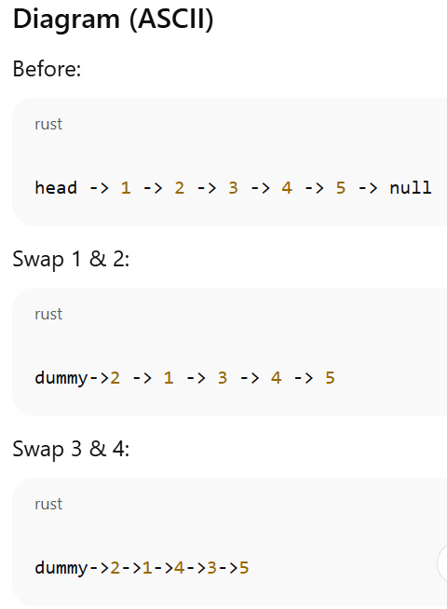
Visualization

Slide 7
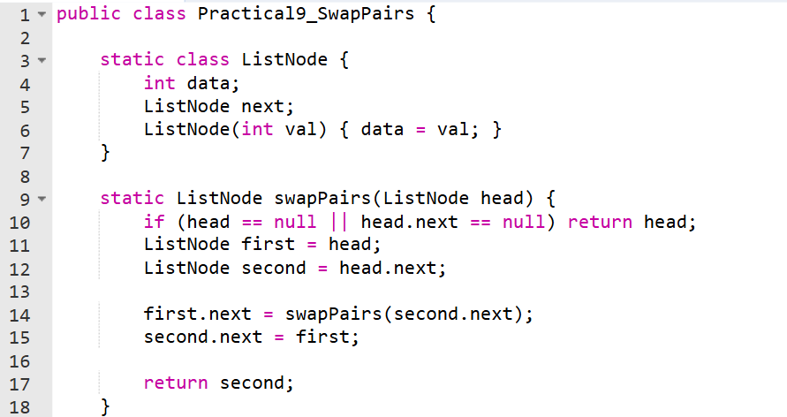
Code Implementation

Slide 8
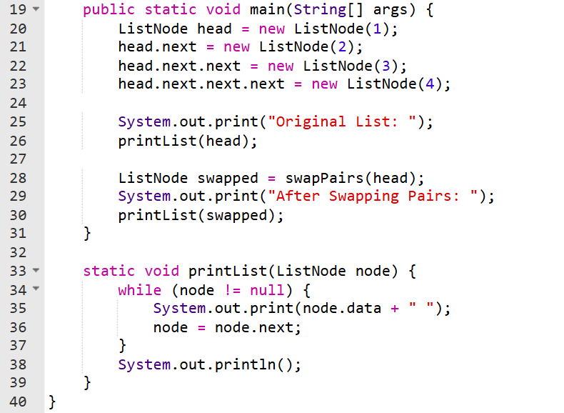

Slide 9
Output :
Original List: 1 2 3 4
After Swapping Pairs: 2 1 4 3

Slide 10
Output
Input Linked List: 1 -> 2 -> 3 -> 4
Output Linked List: 2 -> 1 -> 4 -> 3

Slide 11
Time & Space Complexity
Time Complexity: O(N)
The algorithm iterates through the linked list once, processing each pair of nodes. In each iteration of the while loop, a constant number of operations (pointer assignments) are performed. Therefore, the time taken grows linearly with the number of nodes (N) in the linked list.
Space Complexity: O(1)
The algorithm uses a constant amount of extra space, regardless of the input linked list's size. A dummy node and a prev pointer are created, which consume a fixed amount of memory.
No auxiliary data structures are used that scale with the input size.

Slide 12
Summary
This algorithm efficiently swaps adjacent nodes in a singly linked list.

Slide 13
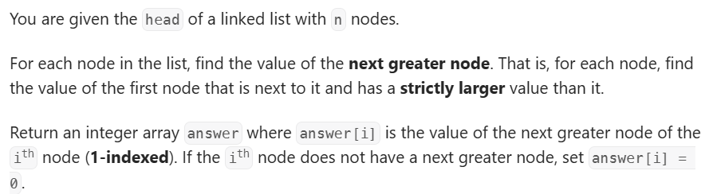
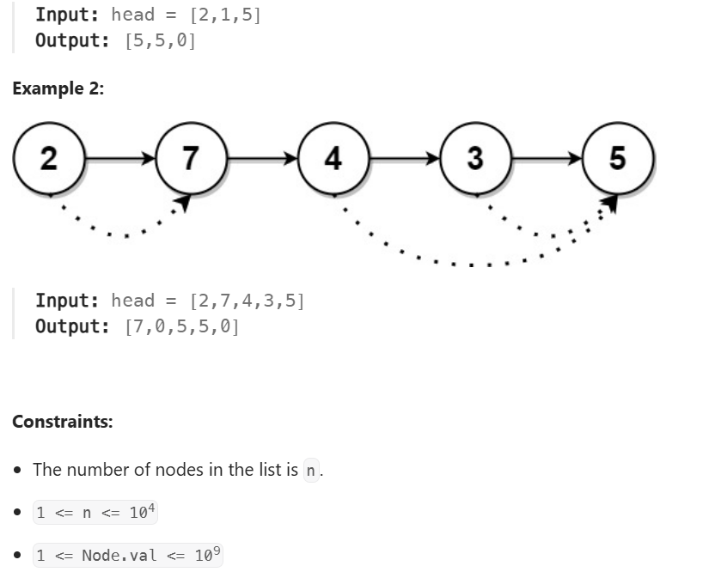
Practice Exercises
Problem Statement 1
Problem Statement Path:
Competitive Coding
Linked List
Next Greater Node in Linked List
Link: https://leetcode.com/problems/next-greater-node-in-linked-list/description/

Slide 14
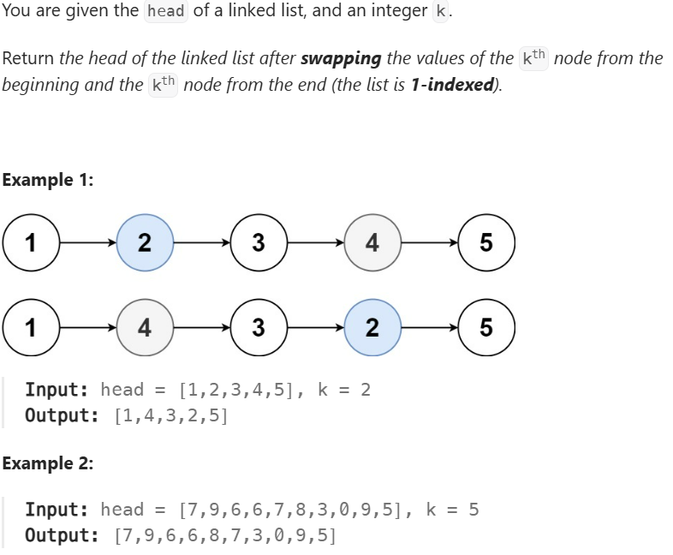
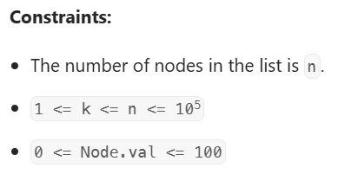
Practice Exercises
Problem Statement 2
Problem Statement Path:
Competitive Coding
Linked List
Swapping Nodes in a Linked List
Link: https://leetcode.com/problems/swapping-nodes-in-a-linked-list/description/

Slide 15
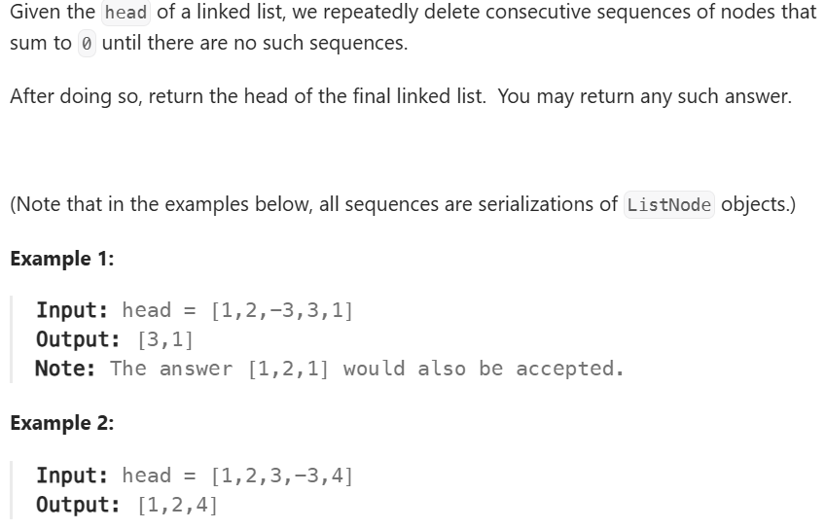
Practice Exercises
Problem Statement 3
Problem Statement Path:
Competitive Coding
Linked List
Remove-zero-sum-consecutive-nodes-from-linked-list
Link : https://leetcode.com/problems/remove-zero-sum-consecutive-nodes-from-linked-list/description/
Constraints:
The given linked list will contain between 1 and 1000 nodes.
Each node in the linked list has -1000 <= node.val <= 1000.

Slide 16
Thanks

